Slide 1
Programming
Intro to python

Slide 2
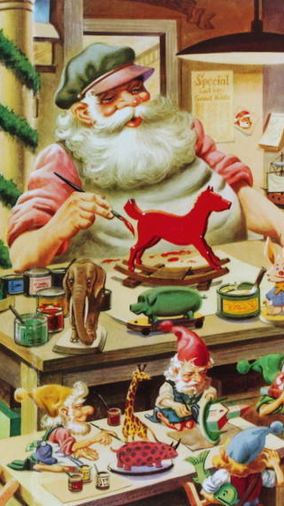
Functions
Defining your own

Slide 3

Defining a Function
Reusable chunk of code

Slide 4
Defining a Function
Reusable chunk of code
Build action from basic functions

Slide 5
Defining A Function
def double(my_name):
answer = my_name + my_name
return answer

Slide 6
Defining A Function
def double(my_name):
answer = my_name + my_name
return answer

Slide 7
Defining A Function
def double(my_name):
answer = my_name + my_name
return answer

Slide 8
Defining A Function
def double(my_name):
answer = my_name + my_name
return answer
arbitrary label for input

Slide 9
Defining A Function
colon
def double(my_name):
answer = my_name + my_name
return answer

Slide 10
Defining A Function
def double(my_name):
answer = my_name + my_name
return answer

Slide 11
Defining A Function
def double(my_name):
answer = my_name + my_name
return answer
indented block

Slide 12
Defining A Function
def double(my_name):
answer = my_name + my_name
return answer

Slide 13
Calling A Function
double(“Rob”)

Slide 14
Calling A Function
def double(“Rob”):
answer = “Rob” + “Rob”
return answer

Slide 15
Calling A Function
double(“Rob”)
no space

Slide 16
Exercises

Slide 17

Debugging
Let’s talk about

Slide 18
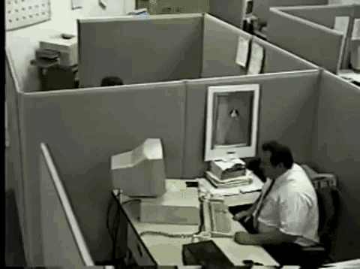
Default Debugging strategy
https://tenor.com/view/office-anger-rage-quit-stressed-gif-11148457

Slide 19
three types of Bugs
Syntactic: Code won’t run
Runtime: Code stops with error
Semantic: Runs, but wrong output

Slide 20
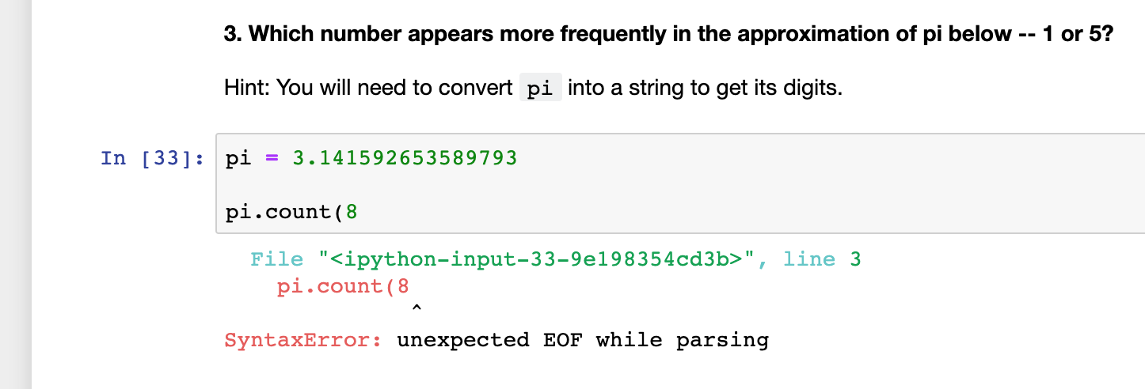
Solving Syntactic Bugs

Slide 21
Solving Syntactic Bugs
Find line number in error

Slide 22
Solving Syntactic Bugs
Find line number in error
Compare your code with recipe

Slide 23
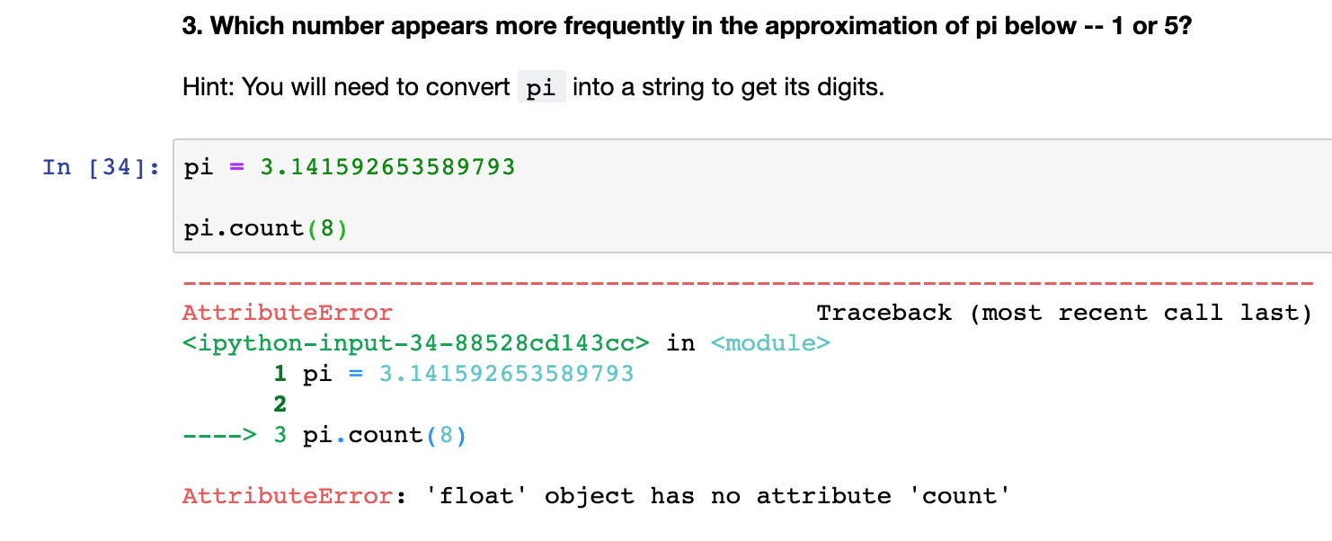
Solving Runtime Bugs

Slide 24
Solving Runtime Bugs
*Double check your data types*

Slide 25
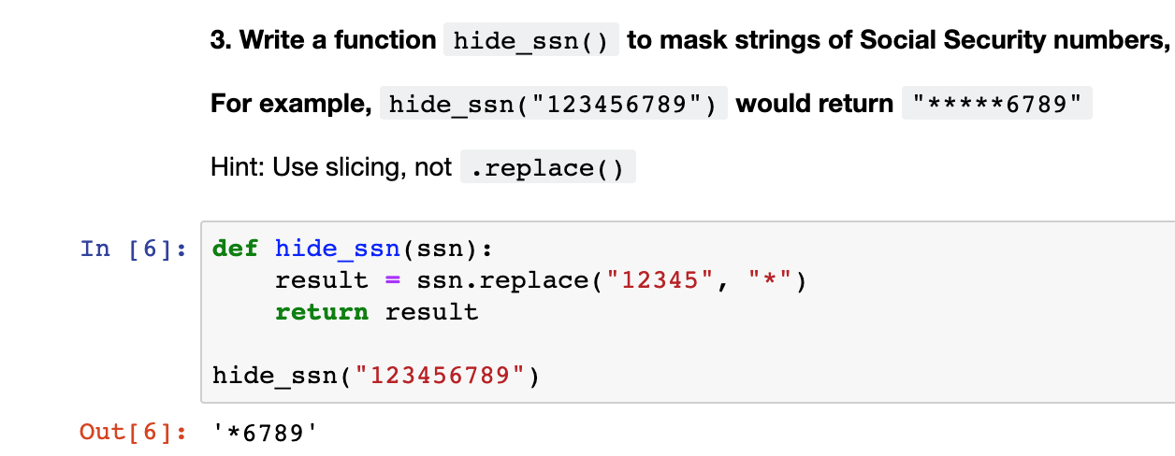
Solving semantic Bugs

Slide 26
Print function
English:
Print value of my_name on the screen

Slide 27
Print Function
English:
Print my_name on the screen

Slide 28
print function
print(my_name)

Slide 29
print function
print(my_name)
“Rob”

Slide 30
print function
print(my_name)
“Rob”
______

Slide 31
Solving semantic Bugs
Print variables halfway through code

Slide 32
Solving semantic Bugs
Print variables halfway through code
Compare outputs with expected values

Slide 33
Solving semantic Bugs
Print variables halfway through code
Compare outputs with expected values
Something weird? Then repeat halfway up your code. Else go halfway down.

Slide 40
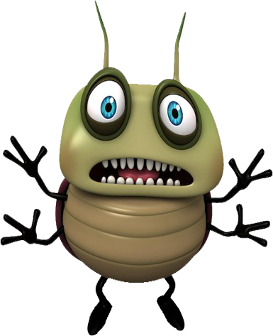

Slide 41
Concepts covered so Far
Syntactic errors
Runtime errors
Semantic errors
print()

Slide 42
Exercises

Slide 43
List
Ordered
No set length or data type

Slide 44
List: Basic usage
my_list = [1, “two”, 3.0]

Slide 45
List: Basic usage
my_list = [1, “two”, 3.0]
list literal

Slide 46
Append
my_list.append(“new thing”)

Slide 47
Append
my_list.append(“new thing”)
_______

Slide 48
List
Mutable
Some methods return no value!

Slide 49
Strings
Immutable
Methods always return new string

Slide 50
Numbers
Immutable
Methods always return new string

Slide 51
List: Basic usage
my_list.append(“new thing”)
print(my_list)

Slide 52
List: Basic usage
my_list.append(“new thing”)
print(my_list)
[1, “two”, 3.0, “new thing”]

Slide 53
Assigning to an index
my_list[0] = “new thing”

Slide 54
Assigning to an Index
my_list[0] = “new thing”
_______

Slide 55
Assigning to an Index
my_string[0] = “?”

Slide 56
Assigning to an Index
my_string[0] = “?”
No! Immutable!

Slide 57
List: Basic usage
last_item = my_list.pop()

Slide 58
List: Basic usage
last_item = my_list.pop()
“new thing”

Slide 59
List: Basic usage
last_item = my_list.pop()
print(my_list)
[1, “two”, 3.0]

Slide 60
List: Basic usage
first_item = my_list.pop(0)

Slide 61
List: Basic usage
first_item = my_list.pop(0)
1

Slide 62
Concepts covered so Far
Lists
Mutability
No return value

Slide 63
Exercises

Slide 64
Sequences
Strings
Lists

Slide 65
StringS: Same
Same index and slice syntax!

Slide 66
StringS: but Different
Cannot add or remove characters

Slide 67
Exercises

